Slide 1

Python Data Processing Workshop
Learn essential techniques for handling data efficiently
Notes:
AI-generated content may be incorrect. ---

Slide 2
Opening
Notes:
Workshop Introduction

Slide 3

Workshop Introduction
Core Programming Concepts
Workshop covers functions, modules, and packages to build foundational Python skills.
Data File Handling
Learn to read and write CSV, JSON, and text files for practical data management.
Error Handling and Logging
Emphasis on exception handling and logging to ensure program reliability and stability.
Using pandas and NumPy
Introduction to pandas and NumPy libraries for data cleaning, transformation, and analysis.
Notes:
This opening section introduces participants to the goals and structure of the Python Data Processing Workshop. It explains that the session will cover core programming concepts—functions, modules, and packages—as well as essential data skills such as reading and writing files in CSV, JSON, and text formats. The introduction also highlights the importance of handling errors using exception handling and logging to make programs reliable. Additionally, participants will learn how to use pandas and NumPy, two powerful Python libraries widely used in data cleaning, transformation, and analysis. The speech emphasizes that all concepts will be presented in simple English to accommodate all learners. It encourages learners to ask questions throughout the workshop and sets expectations for a structured and practical learning experience. The opening also positions the session as a journey from basic Python usage to real-world data workflows, ensuring participants understand how each topic contributes to building complete, efficient, and maintainable data-processing pipelines.

Slide 4
Part 1: Functions, Modules, and Packages
Notes:
Why Functions?, Basic Functions, Modules and Packages, Summary of Part 1

Slide 5

Why Functions?
Code Reusability
Functions enable reuse of code blocks, reducing repetition across programs and improving efficiency.
Modular Program Structure
Functions create clear, modular building blocks that simplify program organization and debugging tasks.
Recipe Analogy
Like a recipe defines steps to prepare a dish, functions define reusable steps in programming tasks.
Foundation for Advanced Topics
Functions serve as the foundation for modules and packages, enabling scalable and organized codebases.
Notes:
This section explains the need for functions in Python and how they support reusability and maintainability of code. By encapsulating logic inside a function, programmers avoid unnecessary repetition and create clear, modular building blocks. The analogy of a recipe helps simplify the concept: the function represents a predefined set of steps, and calling the function is like preparing the dish whenever needed. Functions make large programs manageable because they separate concerns and make debugging easier. This section also prepares learners for later topics, where functions serve as the foundation for modules and packages. Real-world coding becomes significantly easier when tasks such as data cleaning, file reading, or validation are wrapped inside reusable functions. Learners are encouraged to think of functions as the smallest unit of organized and reusable work in a Python project.

Slide 6

Basic Functions
Function Syntax and Structure
The `def` keyword defines a function, which includes a name, parameters, and a body containing executable code.
Function Parameters and Inputs
Functions can accept zero or multiple inputs to process data flexibly depending on the use case.
Return Values and State
Functions may return one or many outputs to pass information or maintain state in a program.
Functions Without Returns
Functions without explicit return statements execute and implicitly return None by default.
Notes:
In this section, learners are introduced to the syntax and structure of a basic Python function. It explains the purpose of the `def` keyword, function names, parameters, and return values. Examples illustrate how functions can take zero or multiple inputs and how they can return one or many outputs depending on the requirement. The explanation includes why returning values helps maintain state and pass information between different parts of a program. Additionally, learners understand that functions without return statements still execute but implicitly return `None`. These foundational concepts are essential for writing clean and organized data-processing code later in the workshop, especially when dealing with transformations, validations, or file operations.

Slide 7

Modules and Packages
Definition of Module
Modules are Python files containing related functions or variables to keep code organized and reusable.
Definition of Package
Packages are directories containing multiple modules and an `__init__.py` file to group related modules logically.
Benefits of Modular Code
Modular code reduces file clutter, improves maintainability, and supports collaboration in larger real-world projects.
Notes:
This section describes how Python programs scale when code is separated into modules and packages. A module is simply a Python file that contains related functions or variables, and it can be imported into other Python files to maintain cleaner architecture. A package is a directory containing multiple modules plus an `__init__.py` file, which signals to Python that the directory should be treated as a package. Learners discover how modules help reduce file clutter and how packages allow grouping related modules logically, such as separating data loading, validation, transformation, and reporting. This prepares participants for working on larger scripts and real-world projects where modular code organization is not only preferable but necessary for clarity, maintainability, and collaboration.

Slide 8
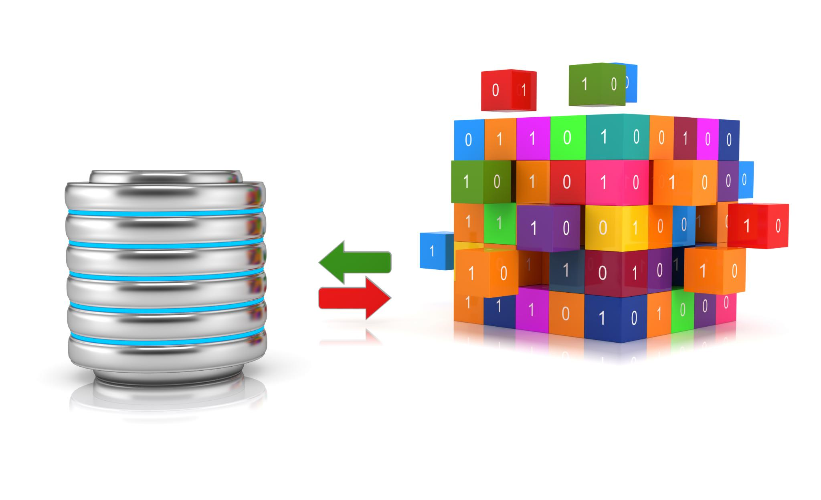
Summary of Part 1
Functions for Reusability
Functions encapsulate logic and enable code reuse, simplifying complex tasks in Python applications.
Modules Organize Code
Modules divide code into separate files, enhancing readability and maintainability of software projects.
Packages Group Modules
Packages group related modules into directories, creating a scalable and manageable project hierarchy.
Importance in Data Processing
Reusable functions and organized modules facilitate data validation, parsing, and transformation tasks efficiently.
Notes:
This summary reinforces the key ideas covered in Part 1: functions allow reusability and encapsulate logic, modules organize code into separate files, and packages group related modules into structured directories. Together, these elements form the structural foundation for any scalable and maintainable Python application. They are especially important in data processing, where repeated tasks such as validation, parsing, and transformations need to be reusable and easy to update.

Slide 9
Part 2: File Handling
Notes:
Why File Handling Matters, Text Files, CSV Files, JSON Files, Summary of Part 2

Slide 10

Why File Handling Matters
Essential File Types
CSV, JSON, and text files are vital for exchanging and storing various data formats and reports.
Fundamental File Operations
Opening, reading, writing, and closing files correctly is crucial for effective data processing.
Avoiding Common Issues
Proper file handling prevents corrupted files, encoding errors, and incomplete data writes.
Notes:
This section explains that working with external data almost always requires reading and writing files. CSV files appear in spreadsheets and exported reports; JSON files are common in APIs, configurations, and structured datasets; and text files are used for logs, notes, and simple data recording. Understanding how to correctly open, read, write, and close files is a fundamental skill in data processing. Participants learn that using file-handling best practices helps avoid common issues such as corrupted files, encoding problems, and incomplete writes. This sets the stage for deeper exploration of text, CSV, and JSON data handling using Python’s built-in libraries.

Slide 11

Text Files
File Opening Modes
Text files can be opened in read, write, or append modes using the open() function for different purposes.
Context Managers Usage
Using context managers with open() ensures automatic file closure even if errors occur during file handling.
Common File Methods
Methods like f.read(), f.readlines(), and f.write() allow reading and writing text data effectively in files.
Uses of Text Files
Text files store logs, configuration values, and simple line-based data, foundational for more complex formats.
Notes:
Text file handling is introduced as the simplest form of file interaction. This section explains how to use `open()` with different modes such as read (`"r"`), write (`"w"`), and append (`"a"`). Learners understand why context managers (`with open(...) as f:`) are preferred—they automatically close files even when errors occur. Examples show how to use `f.read()`, `f.readlines()`, and `f.write()`. Text files are presented as useful for storing logs, configuration values, and simple line-based data. Understanding these basics provides a foundation for working with more structured formats such as CSV and JSON.

Slide 12

CSV Files
CSV Data Representation
CSV files store tabular data with values separated by commas, simplifying data exchange and storage.
Python CSV Module Usage
Python’s csv module provides tools like reader, writer, DictReader, and DictWriter for efficient CSV processing.
Dictionary-Based Reading
Using DictReader preserves column names and reduces errors when accessing CSV data by column headers.
Data Workflow with CSV
Common workflow includes reading CSV, modifying rows, and writing back to a new CSV for data processing.
Notes:
CSV files represent tabular data using comma-separated values. This section shows how Python’s built-in `csv` module helps read and write CSV data using `csv.reader`, `csv.writer`, `csv.DictReader`, and `csv.DictWriter`. Learners discover the advantages of dictionary-based reading, which preserves column names and reduces errors when accessing values. Reading a CSV, modifying rows, and writing the result back to another CSV file is demonstrated as a common and essential data-processing workflow. This section prepares learners for pandas, which offers more advanced tools for handling CSVs efficiently.

Slide 13
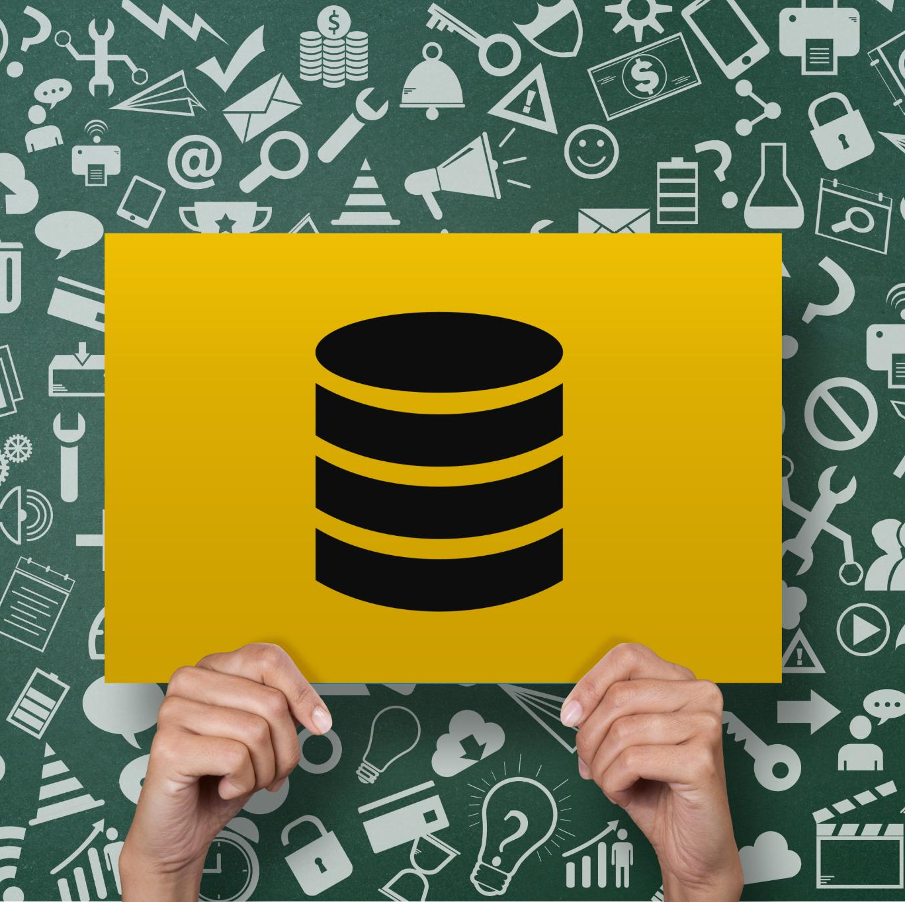
JSON Files
JSON Usage in Web APIs
JSON is widely used to structure data in web applications and APIs for easy data exchange and processing.
json Module Functions
Python's json module provides methods like json.load(), json.dump(), json.loads(), and json.dumps() to handle JSON data.
Mapping JSON to Python
JSON data maps naturally to Python dictionaries and lists, enabling easy manipulation of configurations and API responses.
Notes:
JSON is one of the most widely used formats for structured data, especially in web applications and APIs. This section explains how to use the `json` module, including `json.load()` for reading JSON files, `json.dump()` for writing them, and their string-based counterparts, `json.loads()` and `json.dumps()`. Learners understand how JSON maps naturally to Python dictionaries and lists, making it easy to modify configurations or process API responses. This knowledge will be essential later when combining CSV and JSON data in hands-on exercises.

Slide 14

Summary of Part 2
Text File Handling
Text files are suitable for simple reading and writing operations where data is unstructured or plain text.
CSV for Tabular Data
CSV files are ideal for tabular data and can be handled effectively using the csv module.
JSON for Structured Data
JSON files represent structured hierarchical data, useful for complex data representation and interchange.
Use of Context Managers
Context managers should always be used to safely open and close files across all data formats.
Notes:
This summary reinforces how to handle three common data formats: text files for simple reading and writing, CSV files for tabular data using the `csv` module, and JSON files for structured hierarchical data. Emphasis is placed on always using context managers and understanding when each format is appropriate.

Slide 15
Part 3: Exception Handling and Logging
Notes:
Why Handle Errors?, Try, Except, Else, Finally, Logging, Summary of Part 3

Slide 16

Why Handle Errors?
Unpredictable Data Processing
Real-world data processing is often unpredictable due to missing files, malformed values, or network failures.
Exception Handling Benefits
Exception handling allows programs to anticipate errors and decide appropriate responses to prevent crashes.
Importance of Logging
Logging keeps a record of events and errors, aiding in diagnosing and troubleshooting issues effectively.
Notes:
This section highlights that real-world data processing is unpredictable. Files may be missing, values may be malformed, or networks may fail. Programs that do not handle errors simply crash without explanation. Exception handling provides a structured way to anticipate errors and decide how the program should respond. Logging ensures that the program keeps a record of what happened, making it easier to diagnose issues. These two concepts together form the backbone of any reliable data-processing workflow.

Slide 17

Try, Except, Else, Finally
Try Block Function
The try block runs code that might raise exceptions, initiating error-handling.
Except Blocks Handling
Except blocks catch specific errors like ValueError and handle them gracefully.
Else Block Usage
Else block executes only if no exceptions occur, ensuring normal flow continuation.
Finally Block Purpose
Finally block always runs, perfect for cleanup tasks like closing files or resources.
Notes:
Here, learners explore the mechanics of Python’s error-handling system. The `try` block contains code that might fail, while `except` blocks catch specific error types such as `ValueError` or `FileNotFoundError`. The `else` block runs only when no error occurs, and `finally` always runs, making it suitable for cleanup tasks like closing files or releasing resources. Practical examples help learners understand how to protect critical code sections and provide clear error messages without crashing the entire program.

Slide 18
Summary of Part 3
Exception Handling Importance
Exception handling prevents program crashes by managing unexpected errors effectively.
Value of Logging
Logging tracks execution and errors, providing transparency and aiding debugging.
Enhanced Data Pipelines
Exception handling and logging improve safety, transparency, and debuggability of data pipelines.
Notes:
This summary reinforces the importance of exception handling for preventing program crashes and the value of logging for tracking execution and errors. Together, they make data pipelines safer, more transparent, and easier to debug.

Slide 19
Part 4: Pandas and NumPy
Notes:
Why Pandas and NumPy?, NumPy Basics, Pandas Basics

Slide 20

Why Pandas and NumPy?
NumPy Arrays
NumPy offers fast, memory-efficient arrays that support complex mathematical operations for numerical computing.
Pandas Data Structures
Pandas builds on NumPy to provide high-level data structures like Series and DataFrames for easier data handling.
Data Manipulation Benefits
These tools enable complex data filtering, grouping, merging, and aggregation with less code and improved efficiency.
Notes:
Learners are introduced to pandas and NumPy as essential tools for data manipulation and numerical computing. NumPy provides fast, memory-efficient arrays and mathematical operations, while pandas builds on NumPy to offer high-level data structures such as Series and DataFrames. These tools are crucial when dealing with large datasets, performing transformations, and generating summaries. They allow analysts and developers to write less code while accomplishing more, especially in scenarios involving filtering, grouping, merging, and aggregating data.

Slide 21

NumPy Basics
Creating NumPy Arrays
Learn to create NumPy arrays from lists and generate arrays using built-in functions for efficient data handling.
Vectorized Operations
Perform vectorized mathematical operations that are faster than traditional Python loops for numerical computations.
Indexing and Broadcasting
Explore advanced indexing, shaping, and broadcasting techniques to manipulate and align arrays efficiently.
Performance and Integration
Understand why NumPy accelerates computations and how pandas utilizes NumPy internally for better performance.
Notes:
This section demonstrates how NumPy arrays work, how to create them from lists or using array-generation functions, and how to perform vectorized mathematical operations. Learners explore indexing, shaping, and array broadcasting. These concepts help participants understand why NumPy is faster than pure Python loops and how pandas leverages NumPy internally for performance. With this foundation, learners are better prepared to handle pandas operations efficiently.

Slide 22

Pandas Basics
Series Data Structure
The Series is a one-dimensional labeled array capable of holding any data type, fundamental in pandas.
DataFrame Structure
DataFrame is a two-dimensional labeled data structure with columns of potentially different types, essential for data manipulation.
Loading Data Files
Pandas allows loading data from CSV and JSON files easily using functions like `pd.read_csv()` to create DataFrames.
Notes:
Pandas fundamentals are introduced here, including the Series and DataFrame data structures. Learners see how to load data from CSV and JSON files using `pd.read_csv()` an

